Slide 1


Introduction to Metagenomics and Biome-Shiny
Henrique Costa
Open Day Universities
28/11/2019

Slide 2

Table of contents
Introduction to Metagenomics
16S RNA
16S Pipelines
Analyzing Diversity
OTUs and Sequence Databases
Alpha and beta diversity
Metagenomics applications
Biome-Shiny
Practical example - “dietswap” and Biome-Shiny demonstration

Slide 3
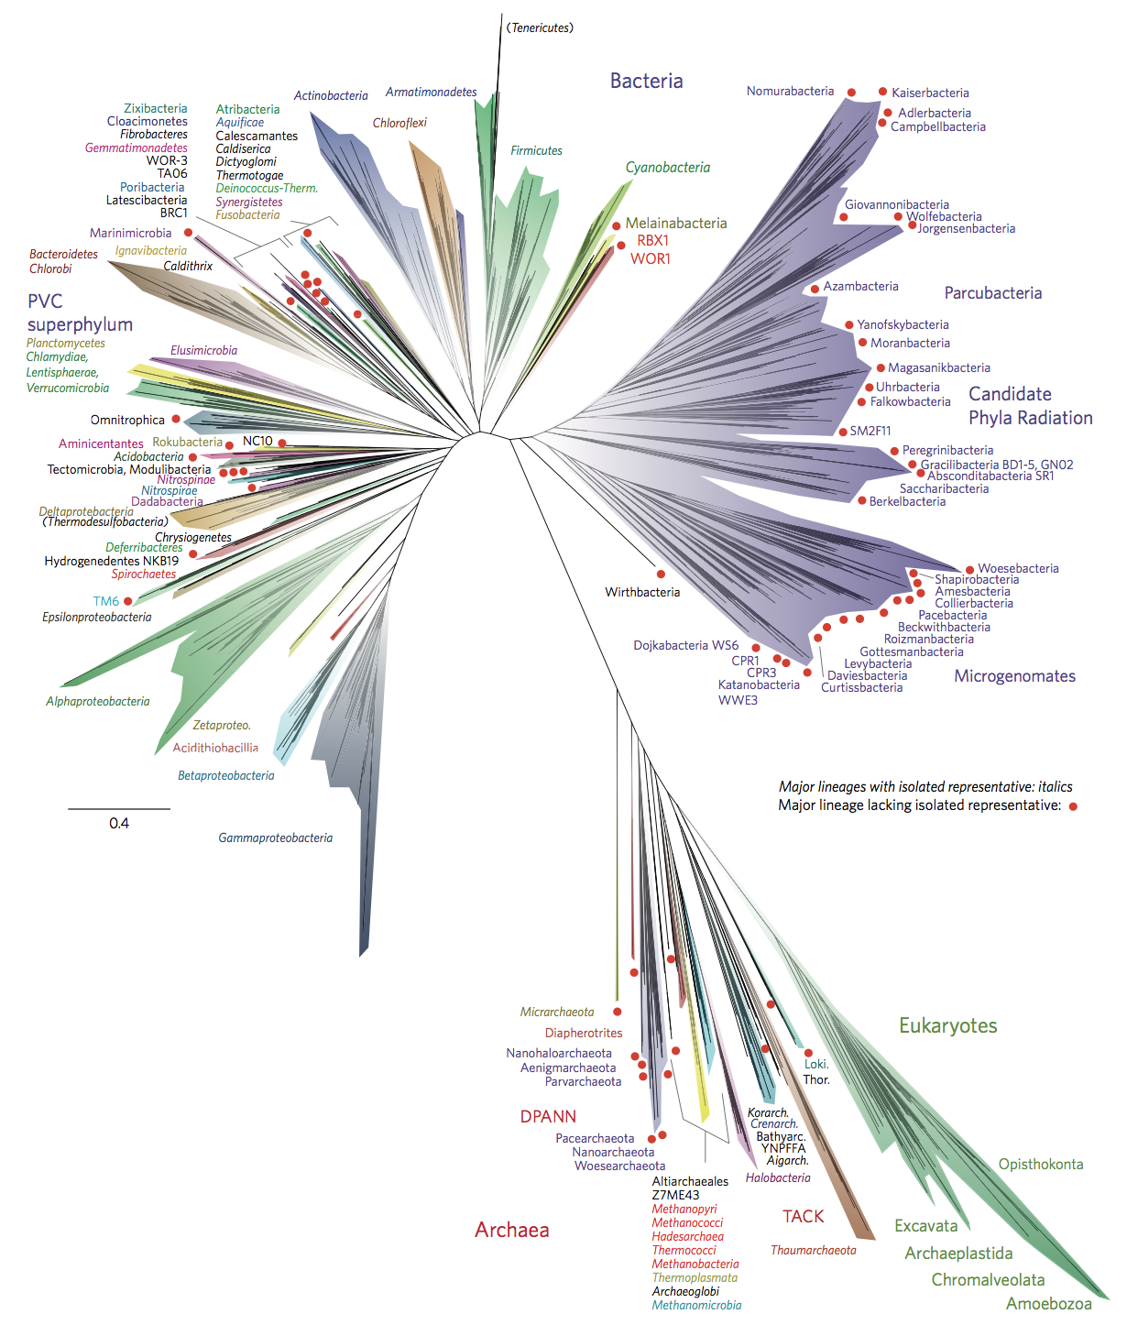
Introduction to Metagenomics
Metagenomics is the study of microbial communities in their original living places, as opposed to the study of cultures.
Microorganisms make up two-thirds of the Earth’s biological diversity, and most of them cannot be cultured by standard techniques.
Therefore, there is a need to use culture-independent methods to understand the genetic diversity, population structure and ecological roles of the majority of organisms.
Nat Microbiol 1, 16048 (2016) doi:10.1038/nmicrobiol.2016.48

Slide 4
Introduction to Metagenomics
There are many communities from which one can extract samples, for a variety of reasons. For example:
Skin, mouth and gut samples to understand human-related disesases;
Soil samples to understand plant-soil interactions;
Marine water samples.

Slide 5
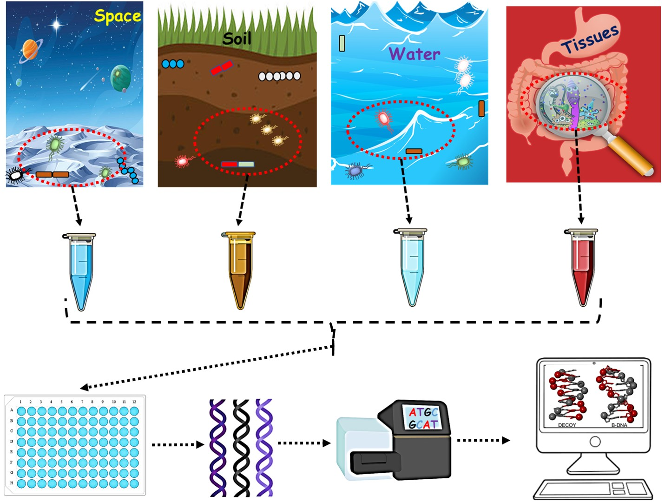
Introduction to Metagenomics
A metagenomics analysis consists on the genomic analysis of microorganisms by direct extraction and cloning of DNA from their natural environment.
https://www.sciwri.club/archives/7530

Slide 6
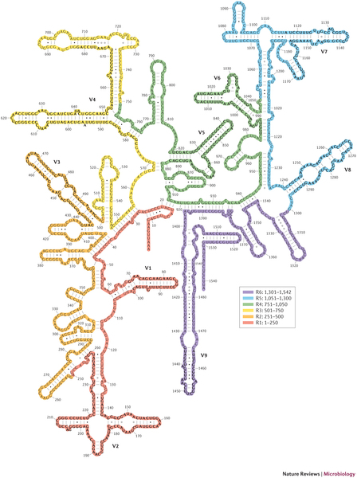
16S rRNA
16S ribossomal RNA is an important marker gene for phylogenetics and bacterial diversity cataloguing.
Present in all bacteria and archaea.
There can be multiple sequences of the gene in a single bacterium.
First used in phylogenetics in 1977, by Carl Woese and George E. Fox.
Image from Alimetrics.net

Slide 7
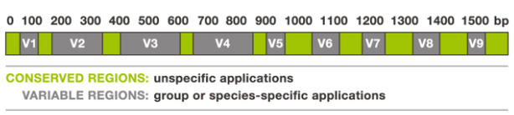
16s rRNA amplicon sequencing
16S rRNA is ideal to develop metagenomics pipelines around, as it has both highly conserved regions and highly variable regions:
Highly conserved regions:
Identical in all bacteria
Single PCR primer pair can amplify 16S rRNA genes from diverse bacteria
Highly variable regions:
Conserved between species
Divergent between species
Image from Alimetrics.net

Slide 8
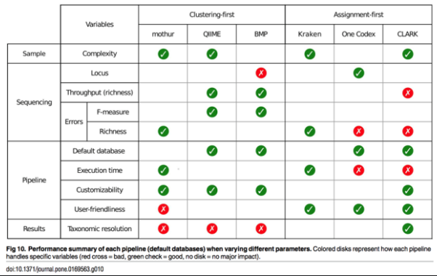
16s Pipelines
Image from Alimetrics.net

Slide 9
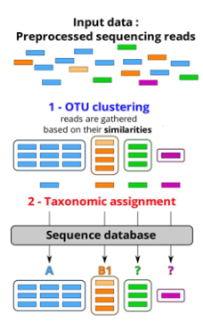
OTUs
Operational taxonomic units (OTUs) are usually defined as a cluster of reads with 97% similarity, with the expectation that these reads correspond approximately to species.

Slide 10
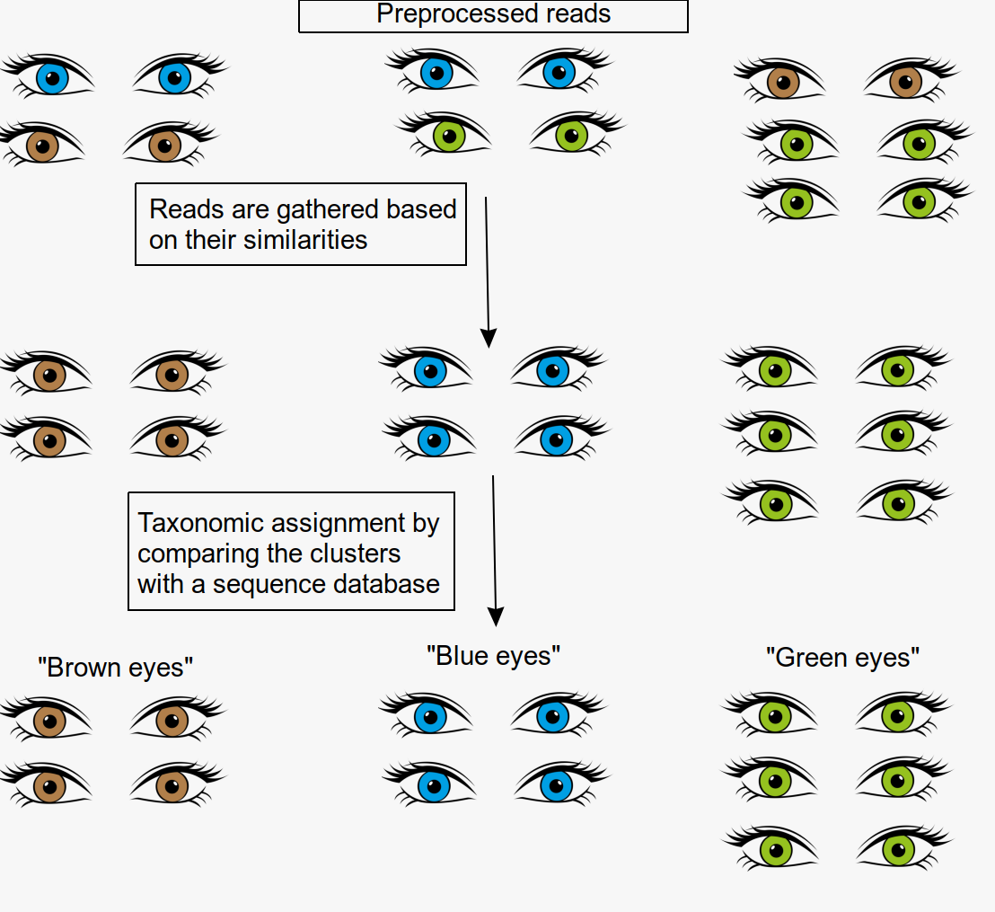
OTUs
Operational taxonomic units (OTUs) are usually defined as a cluster of reads with 97% similarity, with the expectation that these reads correspond approximately to species.

Slide 11



Sequence Databases
There are many 16S available databases with which to perform taxonomic assignment. They can differ in various aspects, such as:
Coverage or number of sequences
Taxonomic classification of sequences
Frequency of updating
Compatibility of data with chosen analysis platform
Databases:
Greengenes (bacteria)
http://greengenes.secondgenome.com
Silva (bacteria, archaea, eukarya)
https://www.arb-silva.de
RDP (bacteria, archaea, fungi)
http://pyro.cme.msu.edu
\

Slide 12
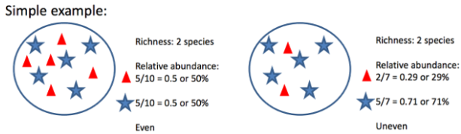
Measuring Diversity
Species richness: Number of different species in a habitat/sample
Species relative abundance: Number of each species, relative to the total number of species in a sample
Species evenness: How close in numbers are each species in an environment.

Slide 13
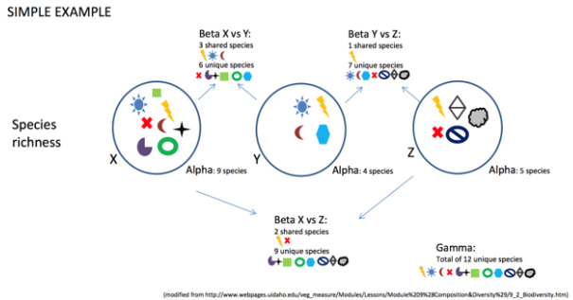
Diversity index
Alpha diversity: Diversity within a habitat/sample
Beta diversity: Diversity between units/samples
Gamma diversity: Total diversity in a landscape

Slide 14
Diversity index
Alpha diversity: Diversity within a habitat/sample
Beta diversity: Diversity between units/samples
Gamma diversity: Total diversity in a landscape

Slide 15
Alpha Diversity
Measures species richness at a local scale
There are several ways to measure it
Ex: Shannon, Simpson (measure richness), Chao1 (likelihood of undiscovered species), Observed species

Slide 16
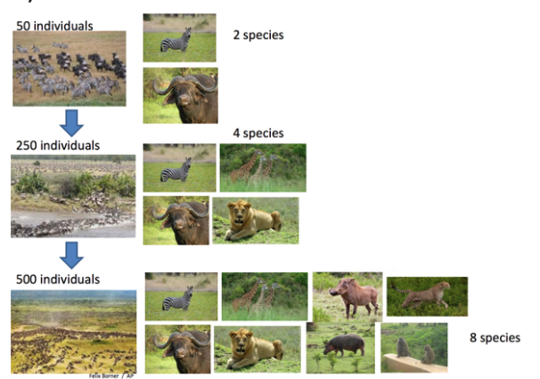
Alpha Diversity

Slide 17
Beta Diversity
Comparison of microbial communities based on their composition.
Metrics assess differences between these communities in:
Overall composition
Comparison of distance matrices → Principal coordinates analysis (PCA)
Composition at varying taxonomic levels
Species, genus, family, etc. → G-tests, ANOVA, etc
Correlation studies → Pearson test

Slide 18
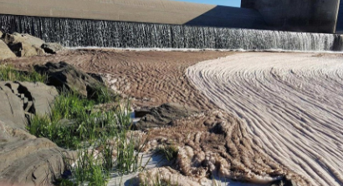
Metagenomics applications
Environmental remediation
Contaminants:
Toxic metals
Fossil fuels
Chemicals
Microorganisms can interact with contaminants and:
Oxidize
Bind
Transform
Immobilize

Slide 19
Metagenomics applications
Agriculture
Detecting diseases in livestock, crops and other products
Understanding soil composition allows for enahnced farming techniques
Soils are rich in microbial communities
Human health
Understanding the relationship between the human body and its microbial communities will lead to new methods for diagnosing, treating and preventing diseases.

Slide 20
Questions?

Slide 21
Biome-Shiny
A tool created to visualize microbiome data with an easy to use graphical interface.
Generates interactive plots and tables.
Allows even those with little programming knowlege to visualize metagenomics data.

Slide 22
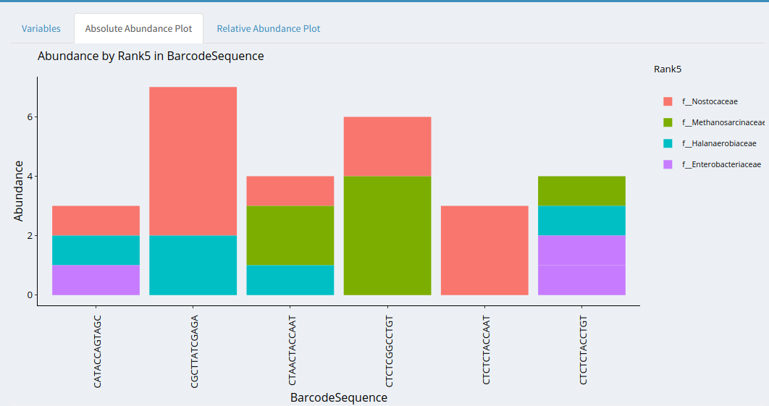

Slide 23
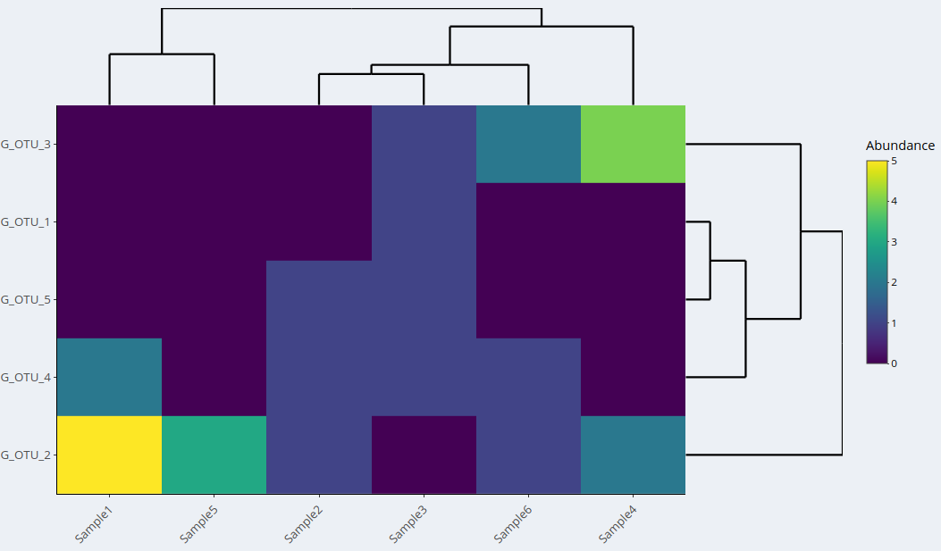

Slide 24
Example: Fat, fibre and cancer risk in African Americans and rural Africans
A study to investigate the role of fat and fibre in African Americans’ relatively high rates of colon cancer (65:100 000) compared to rural South Africans (<5:100 000).
2-week dietary exchange between African Americans with a high-fat, low-fibre western diet and rural South Africans with a high-fibre, low-fat diet.
The different diets lead to significant microbiome changes (for example, Americans were dominated by the genus Bacteroides while Africans were dominated by Prevotella)

Slide 25
Exercise
Exploring Biome-Shiny

